Slide 1
Customer Retention
A Study Based on Different individual consumer factors

Slide 2
What is Customer Retention?
The capacity to keep consumers returning back to your business and investing in it is known as customer retention.
Maintain customer interest and establish trust.
Customer retention guarantees patronage.
It is the practice of encouraging current consumers to keep making purchases from your company.
It’s different from customer acquisition or lead generation because you have already converted the customer at least once.
Your probability of selling to an existing customer is at least 40 percent more likely than converting someone who has never bought from you before.

Slide 3
Benefits Of Customer Retention?
Retained customer will prefer to buy the relevant product and opt for the services from the same company.
Retained customer are always cost effective in nature.
They will refer the products and services to other relatives and members as well, it is called positive publicity. Company get benefited from it via free marketing.
The probability of selling to an existing customer is 60 – 70%
While the probability of selling to a new customer is 5-20%
Decline Migration rate

Slide 4
Analyzing The Customer Feedback
We have customers feedback for e-Commerce websites. In total, we got 269 customer’s reply over 70 questions asked relevant to the online shopping experiences.
Performing the exploratory data analysis to know the significance of each variable on the customer retention.

Slide 5
Variables Holding Significance On Customer Retention
Gender of respondent and How old are you?
Which city do you shop online from? And What is the Pin Code of where you shop online from?
Since How Long You are Shopping Online ? And How many times you have made an online purchase in the past 1 year?
How do you access the internet while shopping on-line? And Which device do you use to access the online shopping?
What is the screen size of your mobile device? And What is the operating system (OS) of your device?
What browser do you run on your device to access the website? And Which channel did you follow to arrive at your favorite online store for the first time?
After first visit, how do you reach the online retail store? And How much time do you explore the e- retail store before making a purchase decision? And What is your preferred payment Option?
How frequently do you abandon (selecting an items and leaving without making payment) your shopping cart?
Why did you abandon the “Bag”, “Shopping Cart”?
The content on the website must be easy to read and understand
Information on similar product to the one highlighted is important for product comparison
Complete information on listed seller and product being offered is important for purchase decision
All relevant information on listed products must be stated clearly
Ease of navigation in website, Loading and processing speed, User friendly Interface of the website and Convenient Payment methods
Trust that the online retail store will fulfill its part of the transaction at the stipulated time
Empathy (readiness to assist with queries) towards the customers and Being able to guarantee the privacy of the customer
Responsiveness, availability of several communication channels (email, online rep, twitter, phone etc.) and Online shopping gives monetary benefit and discounts
Enjoyment is derived from shopping online and Shopping online is convenient and flexible
Return and replacement policy of the e-tailer is important for purchase decision and Gaining access to loyalty programs is a benefit of shopping online
Displaying quality Information on the website improves satisfaction of customers and User derive satisfaction while shopping on a good quality website or application
Net Benefit derived from shopping online can lead to users satisfaction and User satisfaction cannot exist without trust

Slide 6
Observations From The Dataset
There are in total 296 rows and 71 columns in the dataset given.
Our target variable here is "Which of the Indian online retailer would you recommend to a friend?".
All other variables are independent and significantly resulting into the target variable.
We don't have any null values in our dataset plus all the data variables are in object text format.
We have only "What is the Pin Code of where you shop online from?" in integer format, rest of the variables are in object data type.

Slide 7
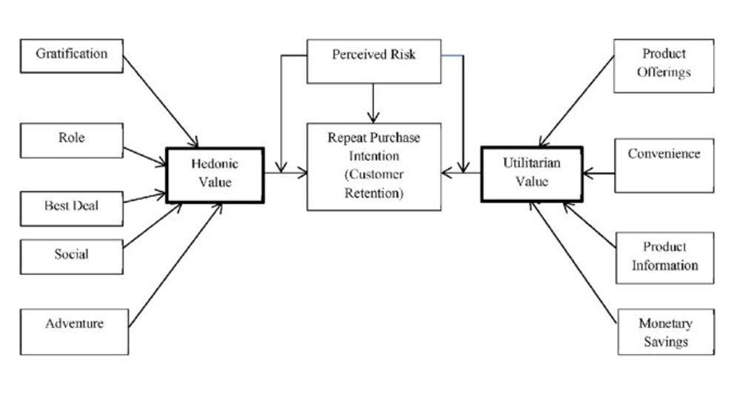
Key To Retain Customers Are As Follows:
Data is about to 5 Companies – Amazon, Flipkart, Myntra, Paytm, and Snapdeal.

Slide 8
Potential Customer:
Females are the potential customer 67.29%
21 – 50 Years are potential age who covers 85% sales

Slide 9
Top 10 Cities For eCommerce

Slide 10
Shopping Pattern is as follows:

Slide 11
How One Do Shop?

Slide 12
How Customer reached to online website?
Customers are somehow know what they need so that they search on search engine like Google

Slide 13
What Does Customer Habit Says On eCommerce?
Female spend more time on ecommerce websites and sometimes abandon the shopping cart

Slide 15
What Online Retailer Are More Preferred?

Slide 16
Observations drawn:
Amazon platform is first choice where online shopping is easy with speedy order delivery
Flipkart platform is second choice of customers
Myntra secured the 3rd place in customers choice
Snapdeal is on 4th position
Paytm is the 5th choice

Slide 17
Observations Drawn:
1. Amazon have variety of products with complete ,relevant information
2. Flipkart is on 2nd choice
3. Myntra is on 3rd Choice
4. Snapdeal secured 4th position
5. Paytm is on 5th position in Product availability category

Slide 18
Platform Technical performance
Conclusion:
Amazon is technically best platform as per customer choices
Flipkart is on the 2nd position in this category
Paytm secured 3rd position on platform stability
Myntra is on 4th position
Snapdeal is on 5th position

Slide 19
Privacy of Customer
Conclusion:
Amazon again on Top position in Customer privacy
Flipkart is on 2nd position
Myntra secured 3rd position on customer privacy matter
Snapdeal is on the 4th position
Paytm somehow not able to gain customers trust

Slide 20
Which of the Indian online retailer would you recommend to a friend?
Clearly, Amazon is leading
In most of the categories to
Customers first recommendation.

